Slide 1

BAD STUCTURED DATA CLEANING
AUTOMATED
OLANREWAJU

Slide 2
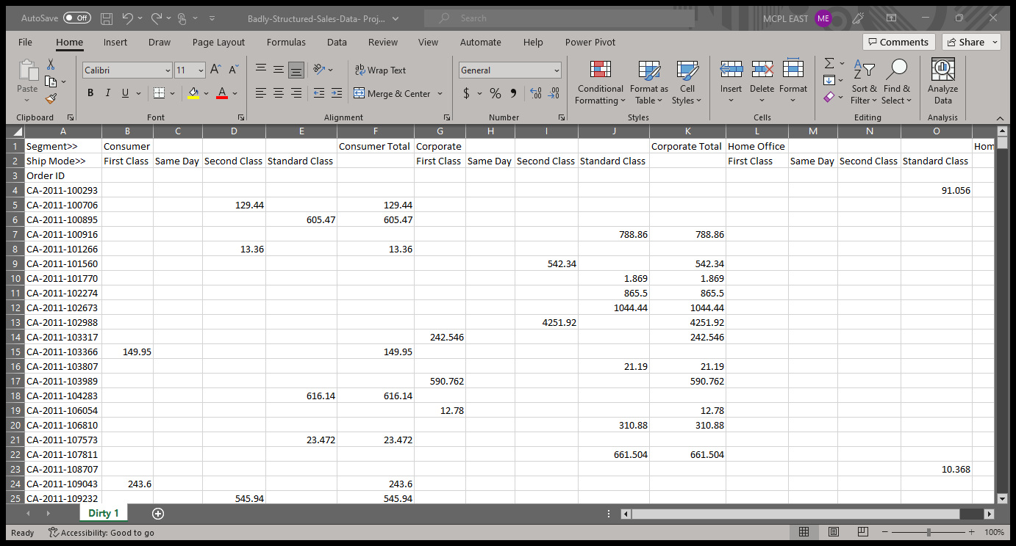
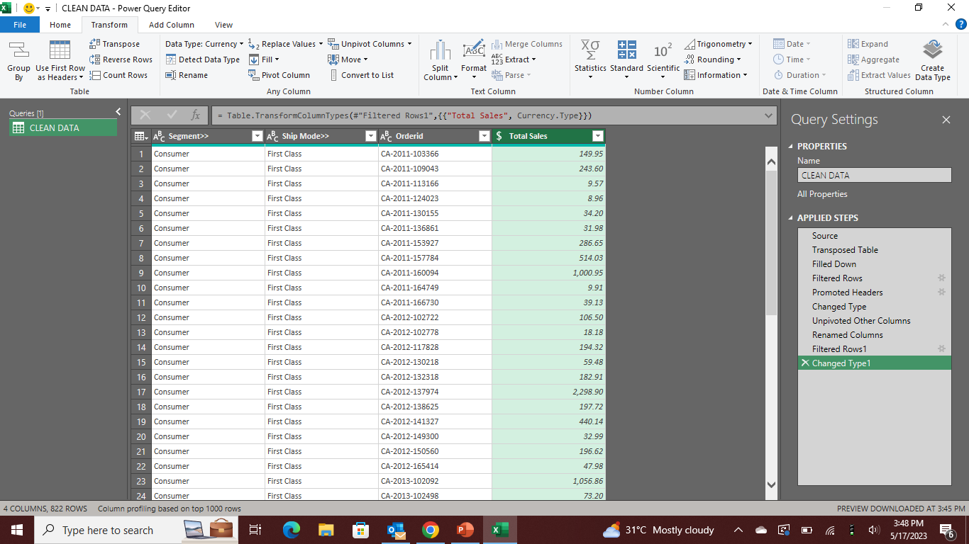
BEFORE AND AFTER CLEANING THE DATASETS

Slide 3
A COMPLETE GUIDE FOR STRUCTURING BAD STRUCTURED DATA IN EXCEL
USING POWER QUERY

Slide 4
HI OLANREWAJU, YOU ARE WELCOME TO THE TEAM; NOW IS THE TIME TO PUT YOUR EXCEL SKILL TO WORK. ONE OF OUR CLIENTS JUST SENT US SAMPLE INVOICES DATA FOR ANALYSIS. THE CLIENT HAS REQUESTED THAT WE PUT THE DATA INTO PROPER SHAPE AND POSSIBLY ASSESS THE QUALITY OF THE DATA. YOUR TASK IS TO AUTOMATE THE DATA CLEANING AND HAVE THIS IN THE PROPER ROWS AND COLUMNS. THERE WILL BE A MEETING WITH THIS CLIENT ON MONDAY 20TH NOVEMBER 2023. PLEASE KINDLY ENSURE THAT THE CLEANED DATA IS AVAILABLE BY THEN. ATTACHED TO THIS EMAIL IS THE DATASETS. HTTPS//:foresightbi.com.ng/wp-content/uploads/2020/05/1.-bad-structured-sales-data-1xlsx KIND REGARDS, DANIEL AYANGBILE SENIOR ANALYST

Slide 5
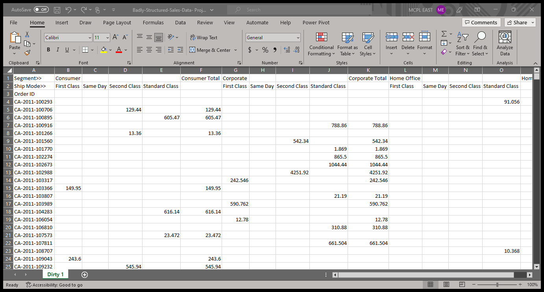
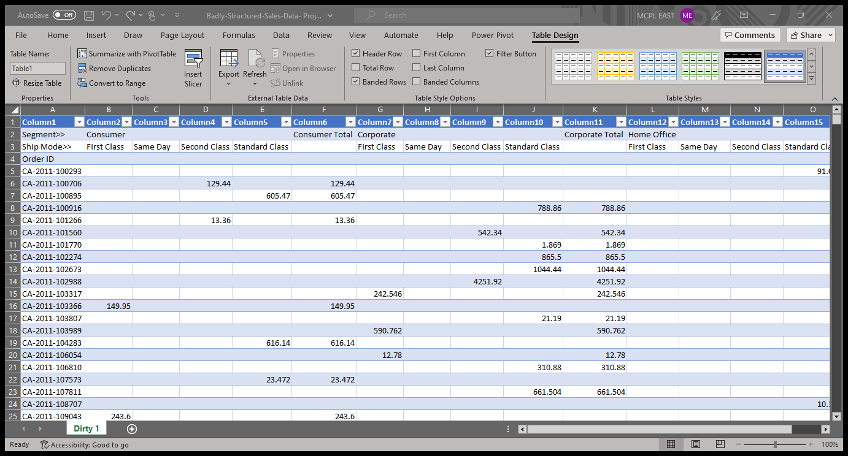
`
uncleaned data
turning data into table

Slide 6
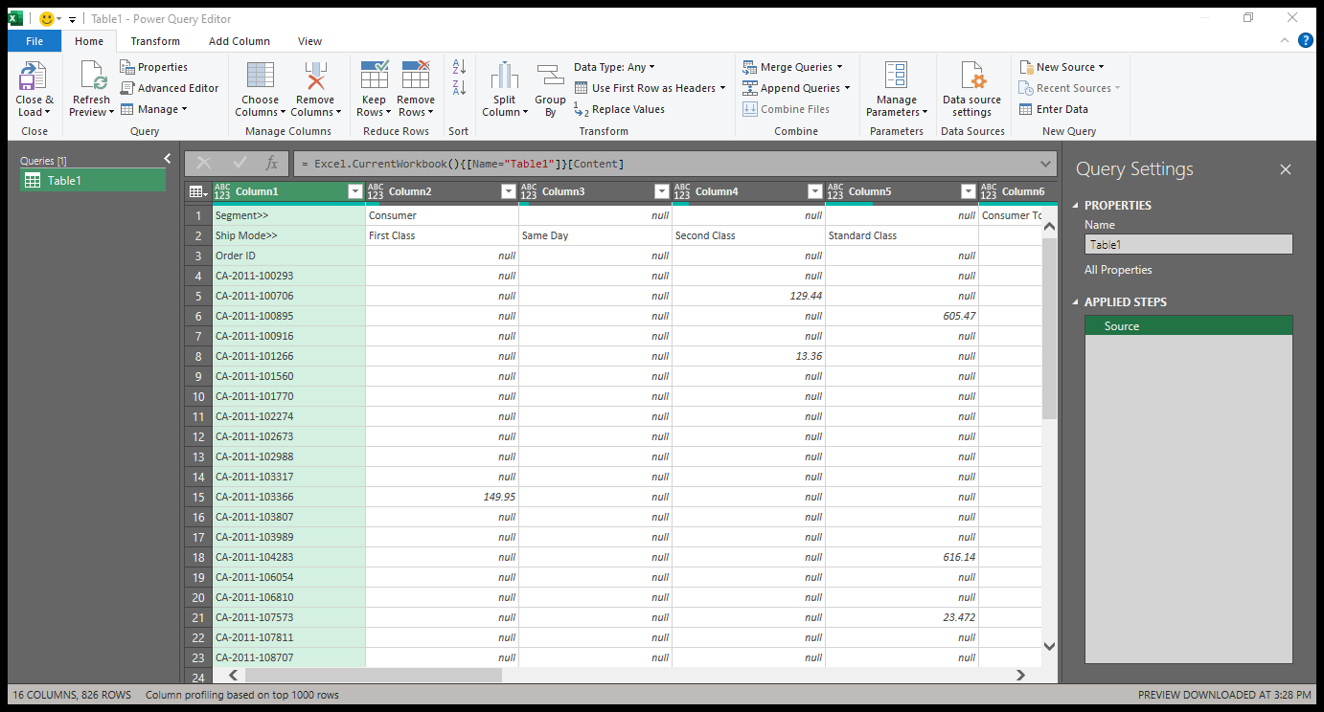
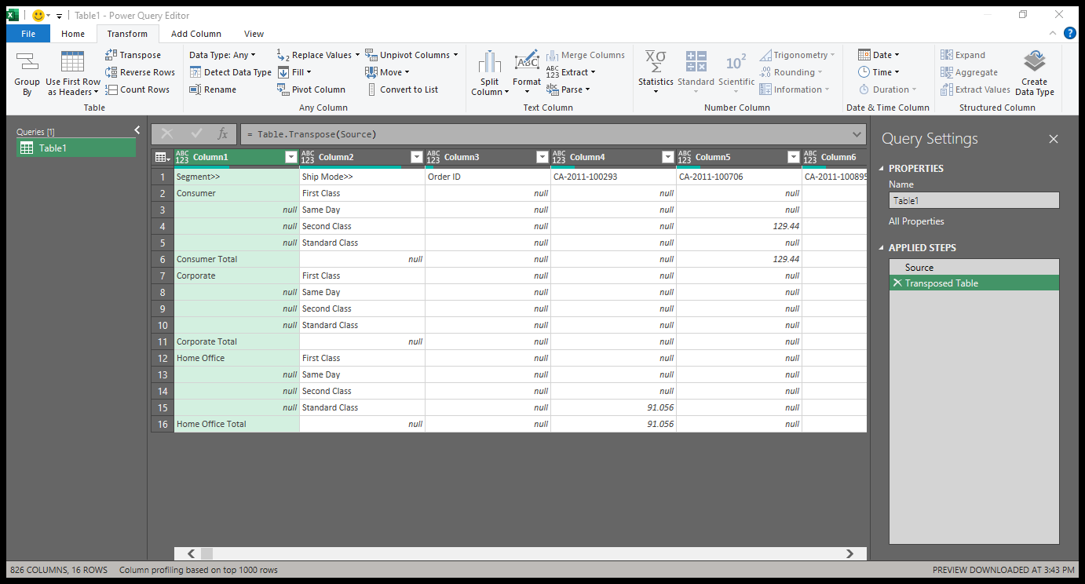
transforming data
data loaded into power query
transposing data

Slide 7

filling empty cells
empty columns to be fill
filled up

Slide 8
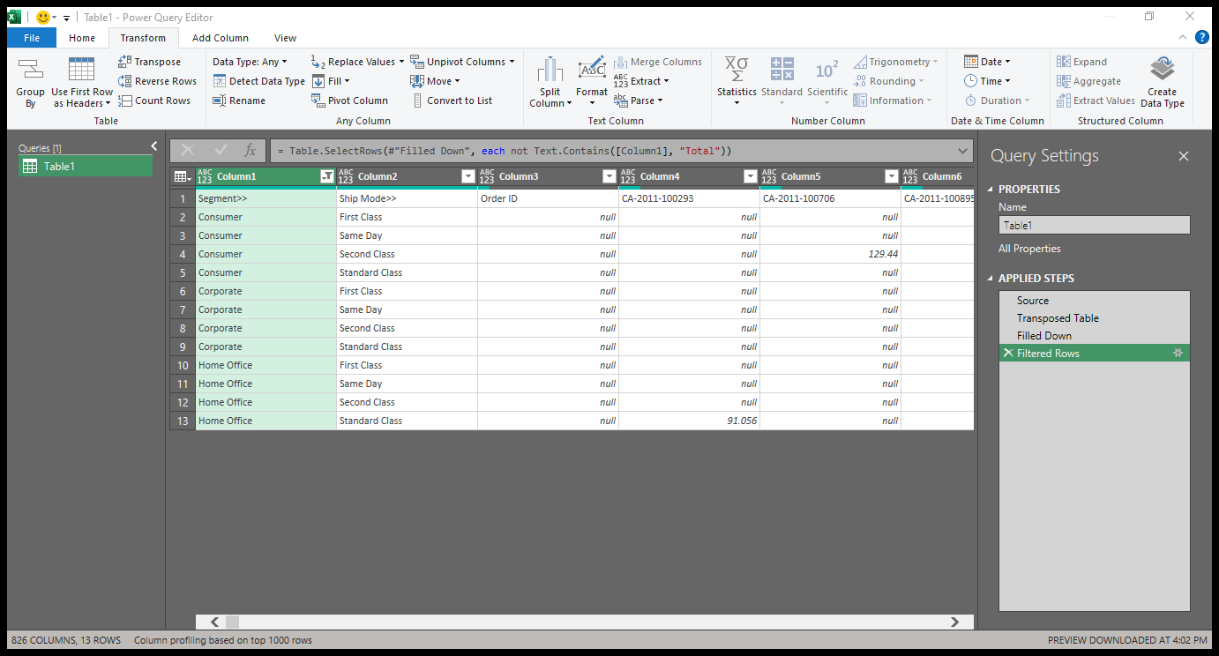
Filtering data
data contain ‘total’
data does not contain ‘total’

Slide 9
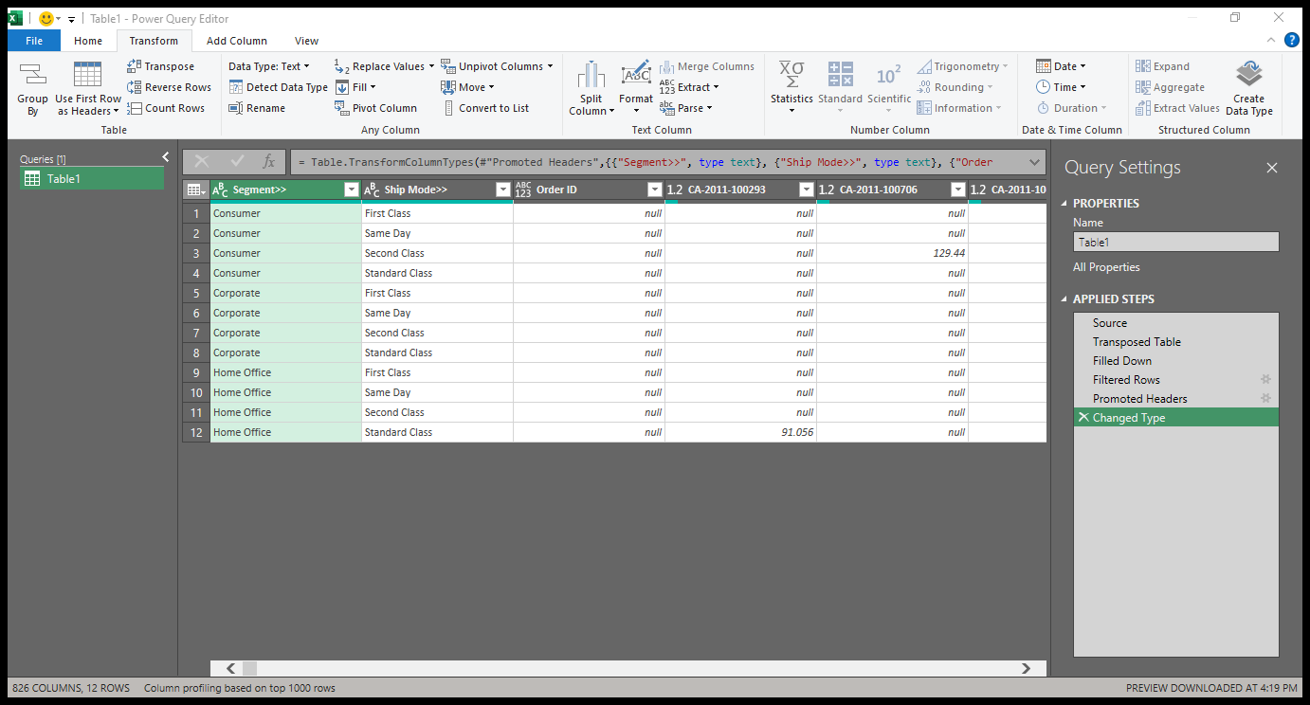
outcome
used first row as header

Slide 10
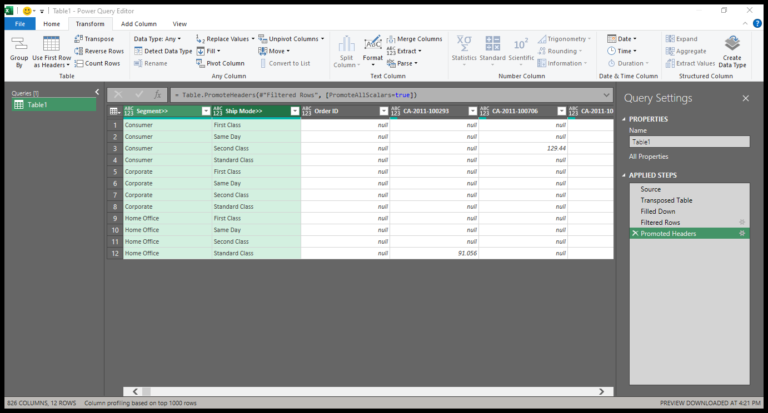
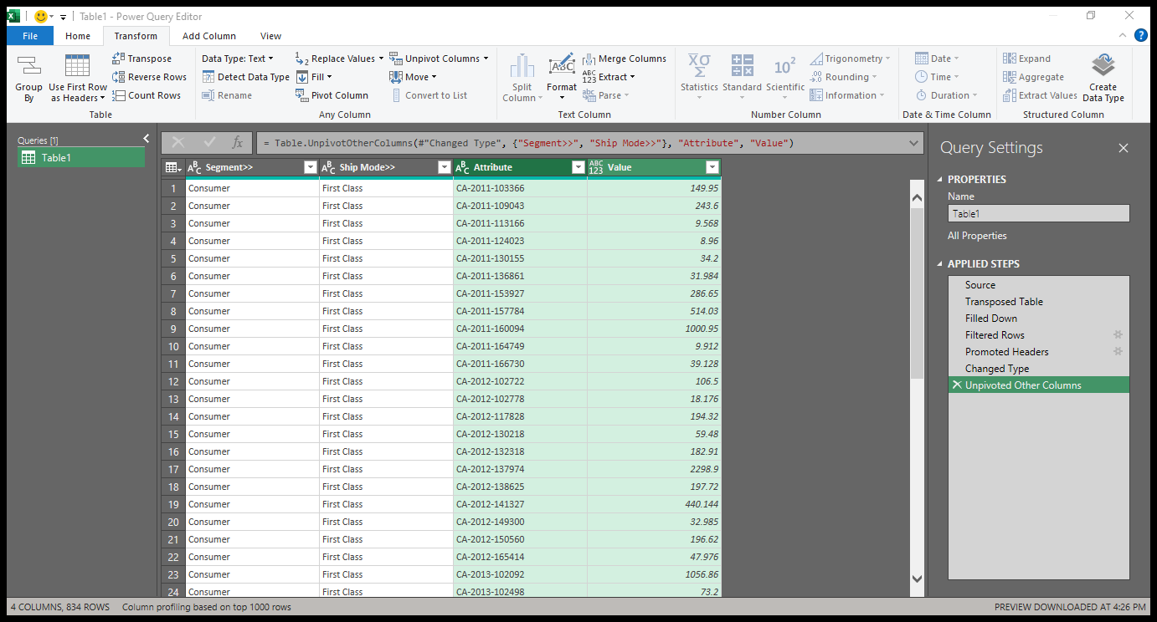
unpivoted columns
unpivoted columns

Slide 11
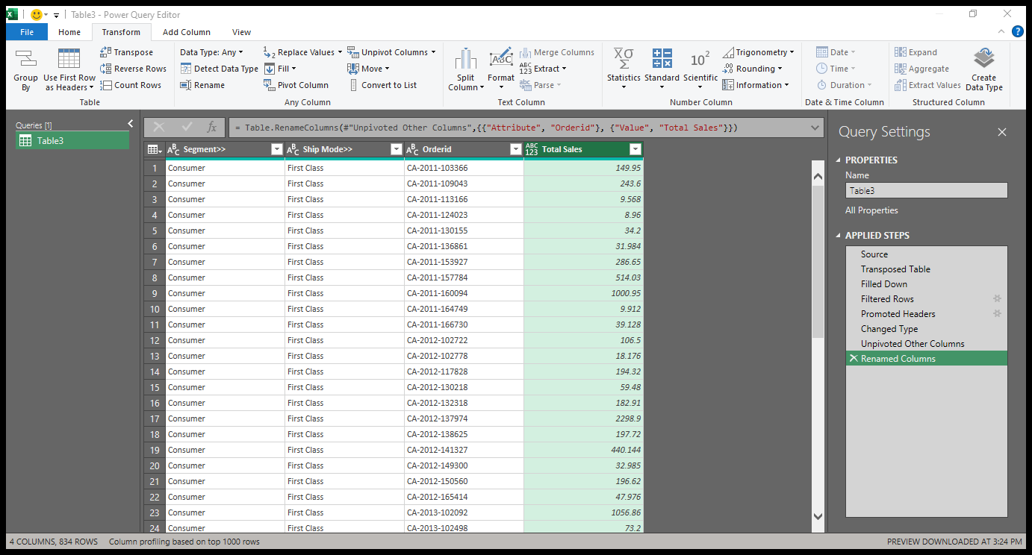
Renamed column
outcome

Slide 12
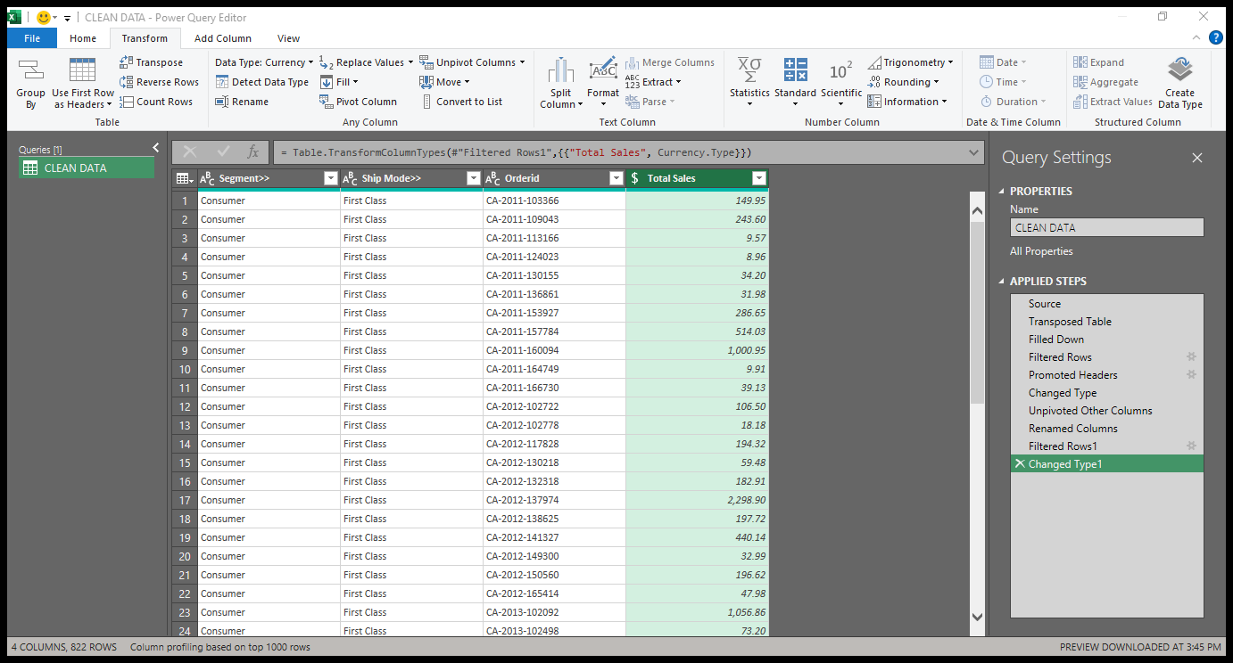
Filtered grand total in column and change data type
unfiltered

Slide 13
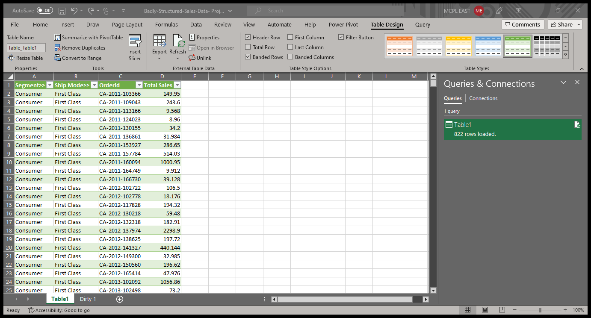
Reporting
Clean data
Result loaded to excel

Slide 14
THIS TOOK ME A COUPLE OF HOURS TO ACHIEVE AUTOMATED DATA CLEANING USING POWER QUERY…

Slide 15
FOR ACCESS TO THE DATASETS AND TO GET YOUR HANDS DIRTY,YOU CAN ALSO USE THE LINK BELOW HTTPS//:foresightbi.com.ng/wp-content/uploads/2020/05/1.-bad-structured-sales-data-1xlsx Use the like, comment, and share buttons as well as following to receive MORE updates : linkedin.com/in/Abiodun-o

